Slide 1
A Multi-Criteria AHP-TOPSIS Model for the Effective Selection of Renewable Energy Sources
Course instructor: Dr. Behin Elahi
ISE 251 : Managing The Lean Enterprise Improvement Program
Group 15
Kavana Pullaganti Sathyanarayana Shradul Sudhir Wadalkar
Naveen Kajjer Anjanappa Mahima Korad Siddalinga Prasad

Slide 2

Introduction
The Increasing global demand for energy, combined with the depletion of finite fossil fuel reserves, has accelerated the urgency of shifting towards more sustainable and diversified energy solutions.
The over-reliance on fossil fuels is proving increasingly untenable, driven by both their environmental cost and diminishing availability, necessitating the exploration of alternative energy systems.

Slide 3

Renewable Energy Selection
The selection of an optimal renewable energy source is a complex decision-making process.
Influenced by multiple factors, including economic feasibility, environmental sustainability, and technical reliability.
The selection of an optimal energy source is a critical aspect of energy transition strategies

Slide 4

Integration of MCDM Techniques
This study employs a hybrid Multi-Criteria Decision-Making (MCDM) framework combining the AHP and TOPSIS.
MCDM is a decision-making process used to evaluate and prioritize multiple alternatives based on several conflicting criteria.
In complex decision scenarios, MCDM techniques help decision-makers choose the best possible.

Slide 5
Objectives
Identify the Optimal Renewable Energy Source: Evaluate and select the most suitable renewable energy source by balancing technical, economic, environmental, and social criteria.
Provide a Decision-Support Tool: Develop a decision-support framework to aid policymakers and stakeholders in formulating data-driven, sustainable energy strategies.
Facilitate Informed Decision-Making: Enable stakeholders to make strategic energy decisions by assessing multiple criteria and future scenarios.
Promote Sustainable Energy Transition: Ensure the selection of energy sources that align with long-term sustainability, economic feasibility

Slide 6
Problem Statement
Lack of Comprehensive Evaluation Framework: Focusing on isolated criteria, failing to consider the broader impact on technical.
Absence of Effective Decision-Support Tools: Integrated, data-driven tools that combine multiple criteria to help formulate balanced and sustainable energy strategies.
Uncertainty in Energy Transition Planning: The complexity of energy transition, with technological and market uncertainties, demands a structured approach.

Slide 7
Data driven MCDM models for reliability-economic-environmental analysis of energy storage based autonomous micro-grid
Literature Review 1
Nishant Thakkar, Priyanka Paliwal (2024)
Objective:
To identify the optimal backup configuration for renewable energy sources (RES) in autonomous micro-grids, based on a comprehensive analysis of economic, reliability, and environmental criteria.
Idea:
Identify components, parameters, modeling methods, and site-specific characteristics for evaluation through literature review and parameter assessment.
MCDM techniques to rank configurations based on aggregated criteria.
Technique:
Parameter Weight Assessment: AHP, BWM, and Ranking methods are used to assign weights.
Alternative Ranking: PROMETHEE II, EDAS and TOPSIS are applied to rank alternatives.
Result:
This study emphasize the importance of integrating sustainable technologies and a comprehensive evaluation framework in autonomous microgrid planning.

Slide 8
Prioritization of Benchmarking Framework for Social Media Content Based on Integration of AHP and Group TOPSIS: A Case Study of Instagram Travel
Literature Review 2
Nurul Akhmal Mohd Zulkefli,Mukesh Madanan,Muhamad Hariz Muhamad Adnan (2022)
Objective:
It combines TOPSIS and AHP to present an innovative model for social media content prioritization.
Idea :
To grade precisely for social media content using multi-criteria decision making (MCDM).
Techniques:
The three hashtags were selected due to their association with the name of the place. Using hashtags, the study examined 75 Instagram profiles. To determine the weights of the criteria for followers, viewers, and posts Eight experts are interviewed. The experts have a range of backgrounds, including social media experience and professional education.
Result :
Each of these metrics' followers, views, and posts contributes to Instagram's popularity, and based on the ranking the top three accounts have the most material.

Slide 9
Literature Review 3
Integrated AHP-TOPSIS under a Fuzzy Environment for the Selection of Waste-To-Energy Technologies in Ghana
Objective:
To provide a robust decision-making framework that supports sustainable energy policies and to identify the optimal Waste-to-Energy (WtE) technology for Ghana by integrating economic, environmental, and technical criteria under uncertain conditions.
Idea:
Perform a comprehensive analysis using MCDM techniques to evaluate various WtE technologies.
Technique:
Criteria weights were calculated using the Fuzzy AHP.
TOPSIS providing a clear prioritization of WtE technologies based on aggregated performance criteria.
Result:
The study underscores the relevance of integrating MCDM tools for robust decision-making, especially in regions with limited data availability and complex stakeholder dynamics.
Sandylove Afrane, Jeffrey Dankwa Ampah, Ephraim Bonah Agyekum, Abdulfatah Abdu Yusuf, Mokhtar Shouran , Islam Md Rizwanul Fattah , Guozhu Mao , Salah Kamel, Prince Oppong Amoh, Ebenezer Agbozo, Elmazeg Elgamli, Salah Kamel

Slide 10
A Hybrid Decision-Making Framework for Sustainable Selection of Lean Manufacturing Tools Using AHP and Grey-TOPSIS
Literature Review 4
Ali Jaber Naemah, Kuan Yew Wong(2022)
Objective:
To provide a robust decision-making framework that supports sustainable energy policies and to identify the optimal Waste-to-Energy (WtE) technology for Ghana by integrating economic, environmental, and technical criteria under uncertain conditions.
Idea:
Perform a comprehensive analysis using MCDM techniques to evaluate various WtE technologies.
Technique:
Criteria weights were calculated using the Fuzzy Analytical Hierarchy Process
TOPSIS, providing a clear prioritization of WtE technologies based on aggregated performance criteria.
Result:
The results identify the most appropriate WtE technology, balancing economic viability, environmental sustainability, and technical feasibility.
The study underscores the relevance of integrating MCDM tools for robust decision-making, especially in regions with limited data availability and complex stakeholder dynamics.

Slide 11
Why Use MCDM?
Manage Conflicting Factors MCDM helps tackle decisions where criteria like cost, efficiency, and environmental impact clash, making it easier to balance these trade-offs.
Structured and Clear Decision Process It provides a step-by-step approach to assess options, combining tools like AHP to weigh criteria and TOPSIS to rank choices effectively.
Fair and Reliable Analysis By using mathematical models, MCDM ensures decisions are based on logic and consistency, minimizing personal bias.
Flexible for Complex Scenarios This method works well for challenging problems, like choosing renewable energy sources, and can be adapted to different industries and regions.

Slide 12
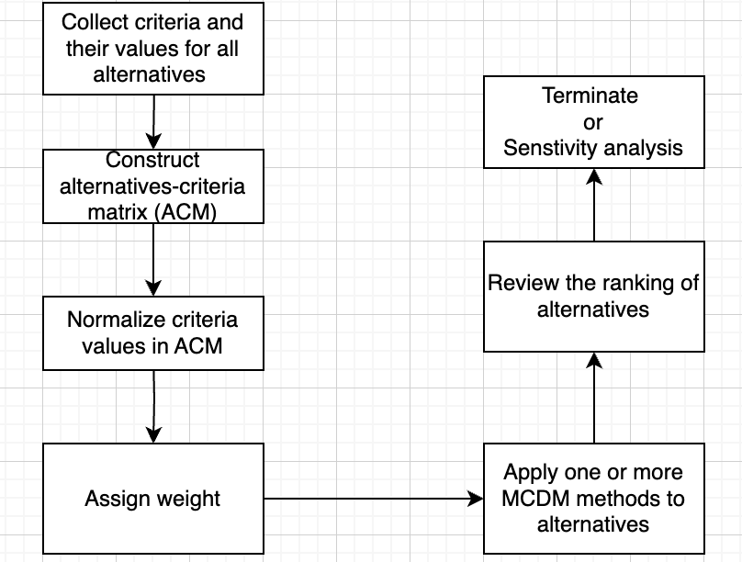
Steps in MCDM

Slide 13
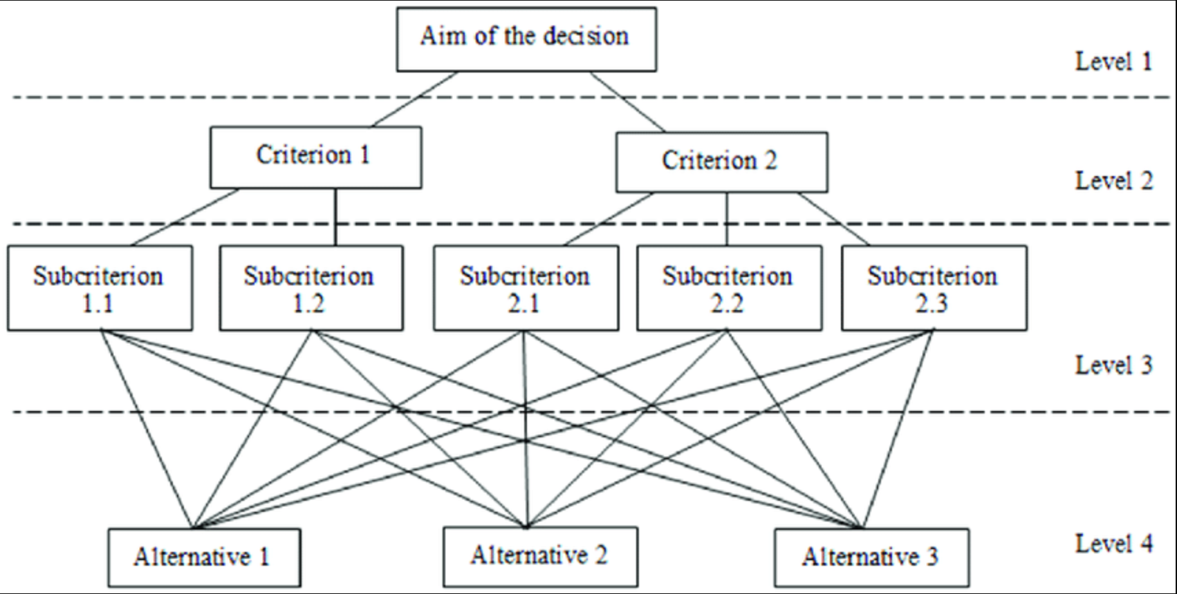
AHP
The Analytic Hierarchy Process (AHP) is a decision-making method that structures problems hierarchically, uses pairwise comparisons to prioritize criteria, and ensures logical consistency through mathematical validation.
AHP for This Project
Criteria Weighting: Accurately quantifies the importance of factors like cost, efficiency, and emissions.
Integration with TOPSIS: Seamlessly provides weights for improved alternative ranking.
Consistency Check: Ensures logical and unbiased decisions.
Customizable: Tailored for renewable energy evaluations, accommodating diverse factors.

Slide 14
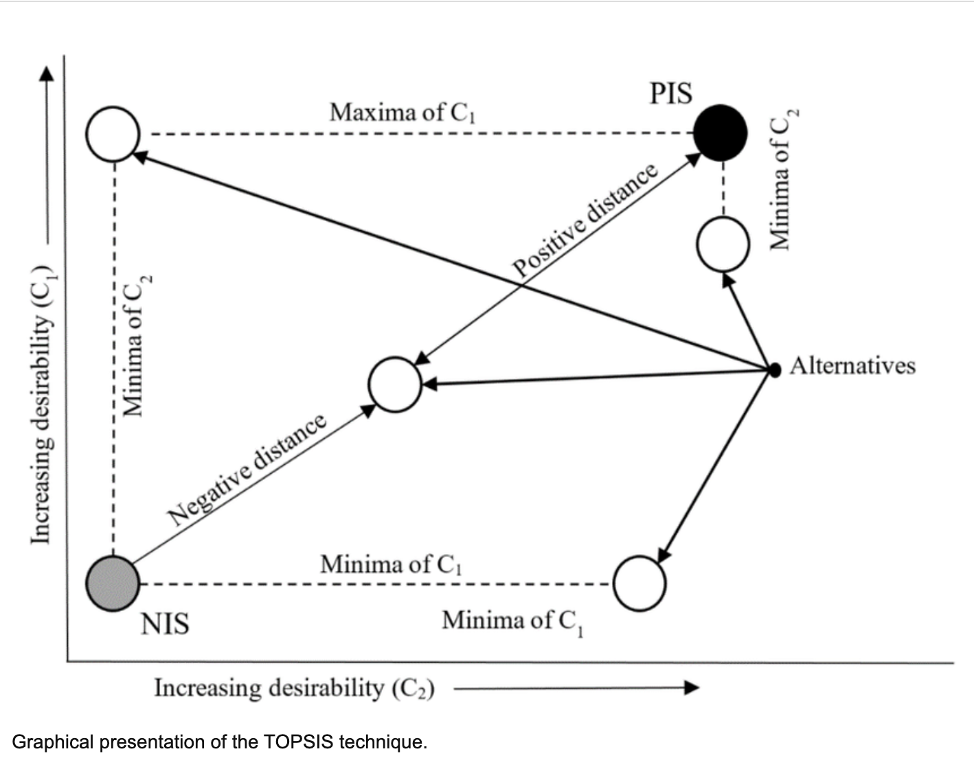
TOPSIS
The Technique for Order Preference by Similarity to Ideal Solution (TOPSIS) ranks alternatives by measuring their distances from an ideal solution (best) and a negative ideal solution (worst).
Distance-Based Evaluation:
Alternatives (renewable energy sources) were ranked by calculating their relative closeness to ideal (best performance across criteria) and negative ideal solutions (worst performance).
Integration with AHP:
AHP-provided weights were applied to normalize the decision matrix, ensuring accurate rankings based on the project’s sustainability criteria.

Slide 15
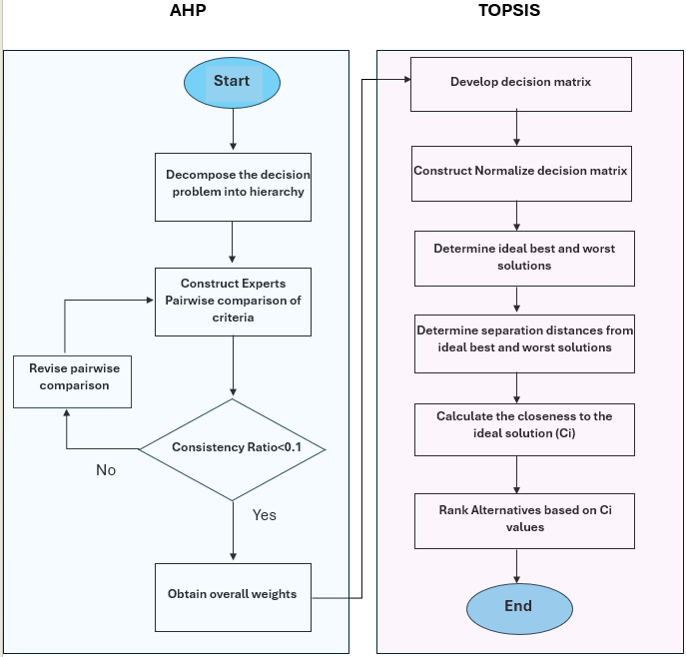
METHODOLOGY

Slide 16
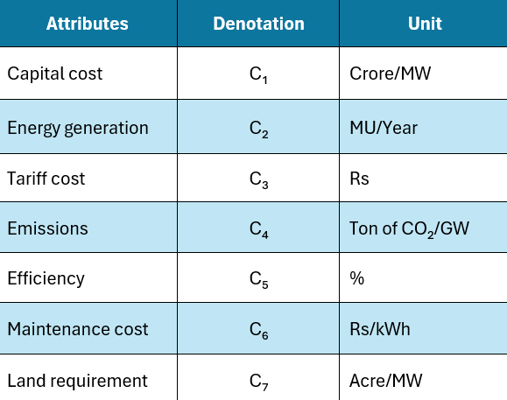
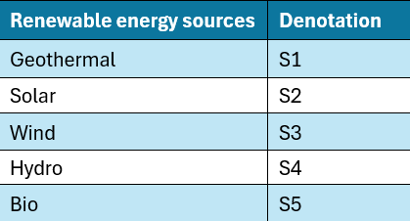
CRITERIA
ALTERNATIVES

Slide 17
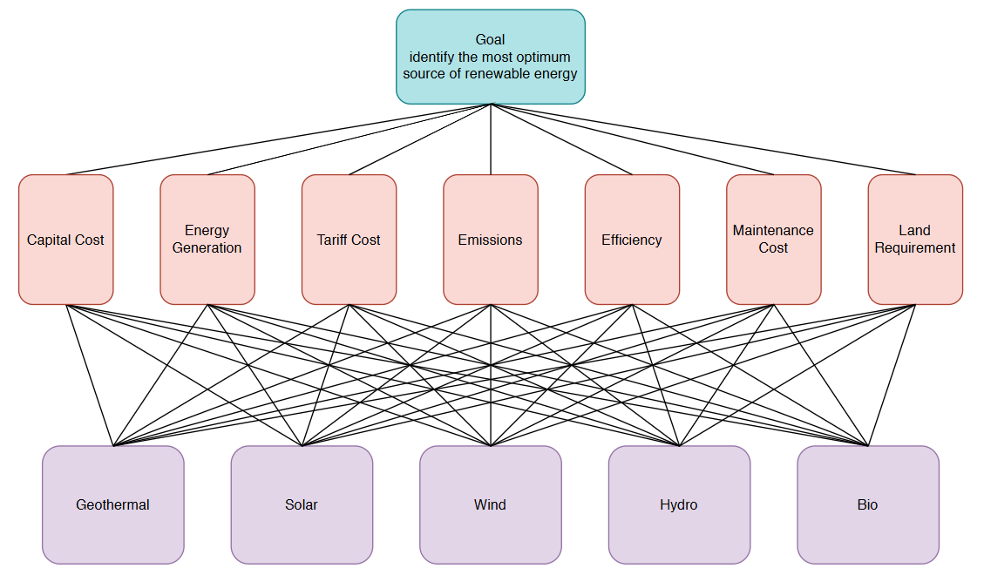
HIERARCHY STRUCTURE
LEVEL 0
LEVEL 1
LEVEL 2

Slide 18
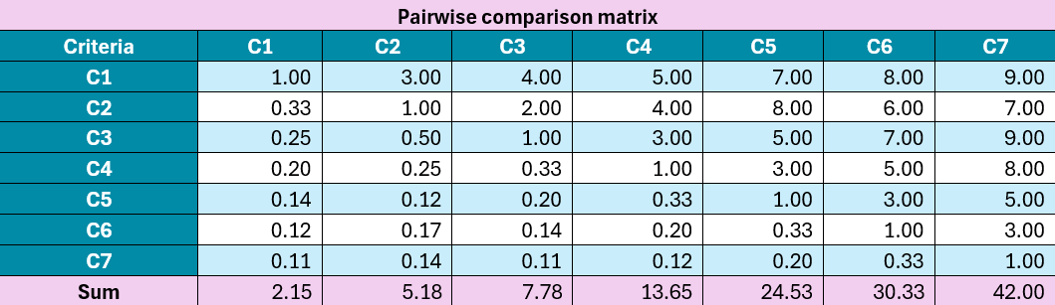
STEP 1: PAIRWISE COMPARISON MATRIX

Slide 19
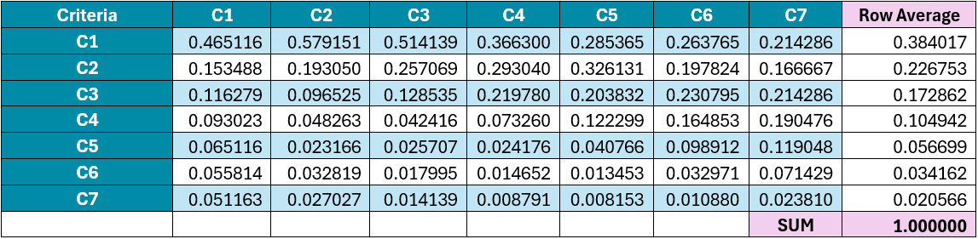
STEP 2 : NORMALIZED MATRIX

Slide 20
STEP 3 : ASSIGNING WEIGHTS TO CRITERIA

Slide 21
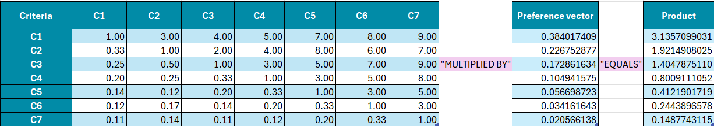
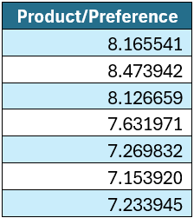
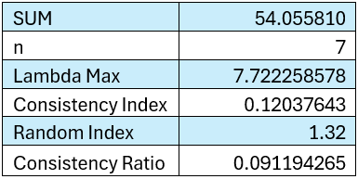
STEP 4 : CHECK FOR CONSISTENCY AND VALIDITY
Since CR<0.1, the degree of consistency is satisfied

Slide 22
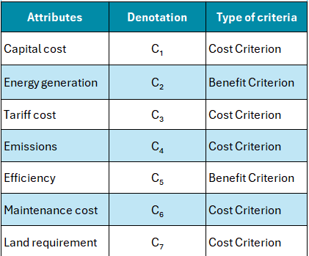
STEP 5 : CATEGORIZING THE CRITERIA

Slide 23
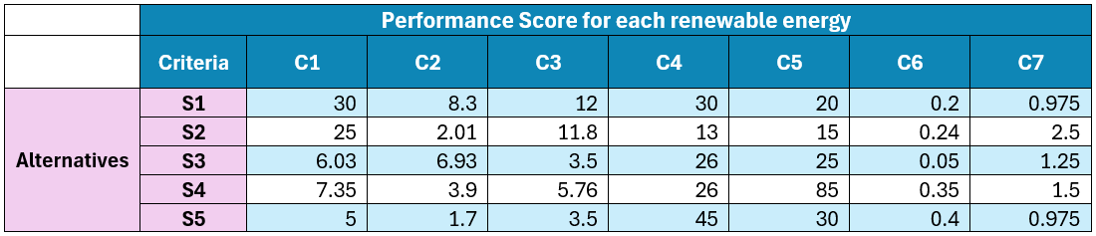
STEP 6 : PERFORMANCE SCORE MATRIX

Slide 24
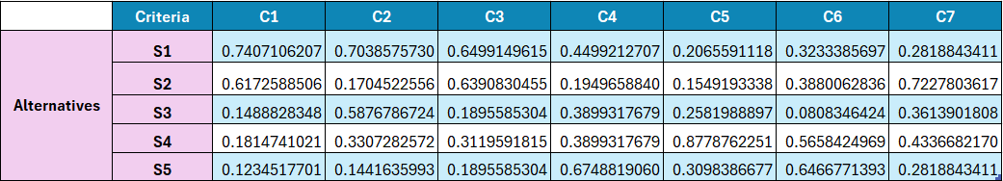
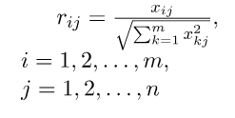
STEP 7 : NORMALIZED MATRIX

Slide 25
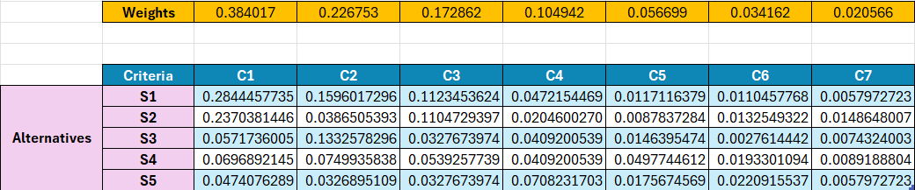
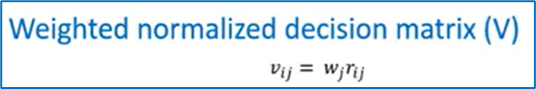
STEP 8 : WEIGHTED NORMALIZED MATRIX

Slide 26
STEP 9 : IDEAL BEST AND WORST CALCULATION

Slide 27
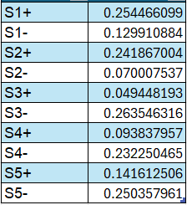
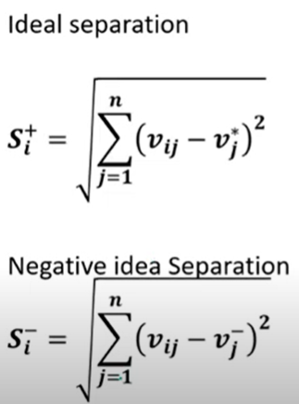
STEP 10 : SEPARATION FROM IDEAL BEST AND WORST SOLUTION

Slide 28
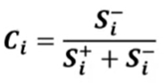
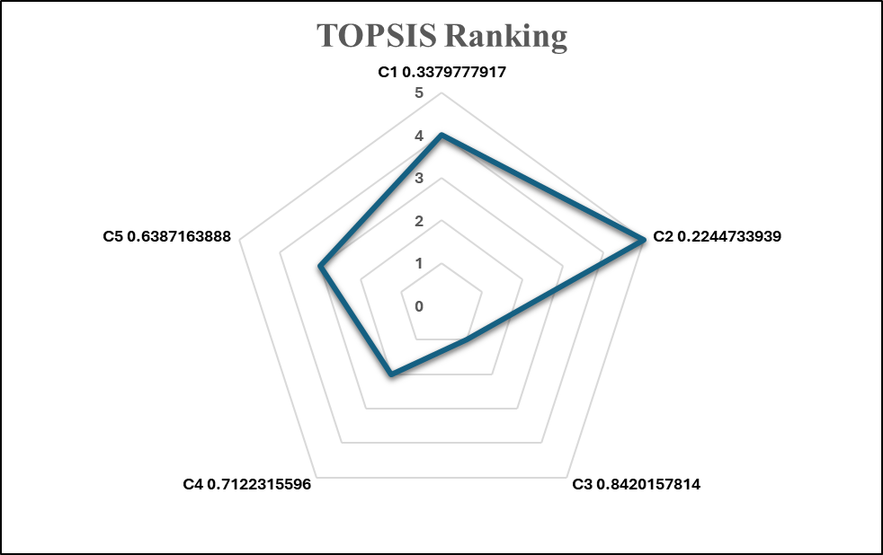
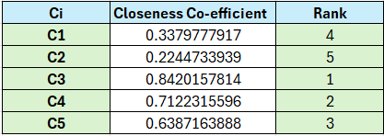
STEP 11: RANKING ALTERNATIVES BASED ON C(i) VALUES
GEOTHERMAL
BIO
SOLAR
HYDRO
WIND

Slide 29
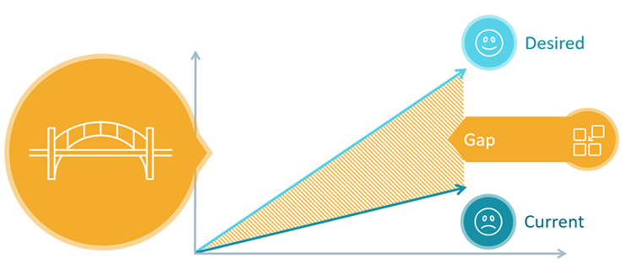
VIKOR(VIšekriterijumsko KOmpromisno Rangiranje)
VIKOR is type of MCDM technique which provides a compromise solution close to the ideal solution by considering group utility and individual regret.
This also helps decision-makers identify the most balanced option closest to an ideal solution.
The steps for performing VIKOR Analysis:
Define the decision Matrix
Normalize the decision Matrix
Calculate the ideal and Worst values
Compute Utility and Regret Measures
Compute the VIKOR Index (Qi)
Rank the Alternatives

Slide 30

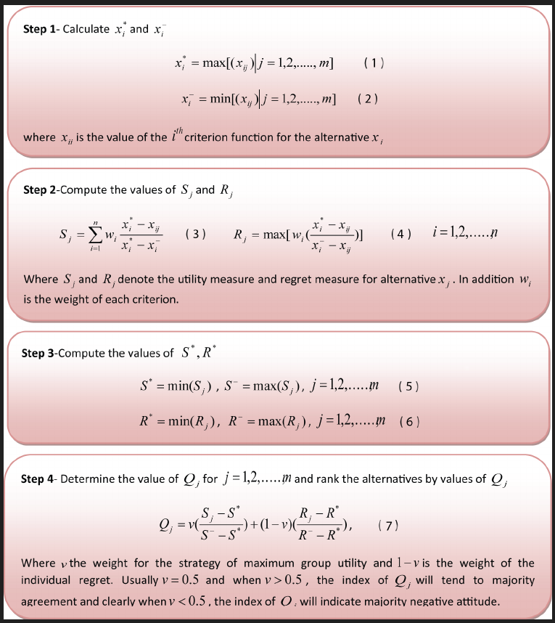
VIKOR Analysis

Slide 31
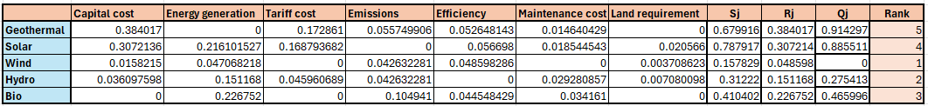
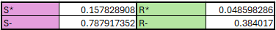
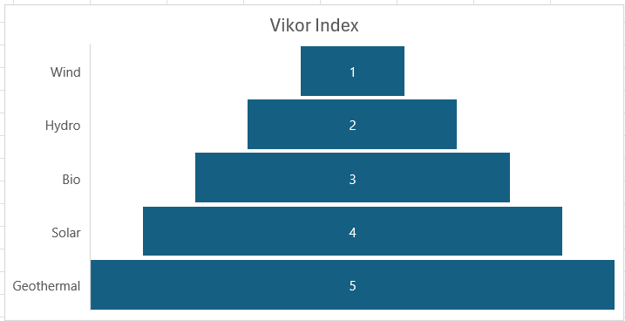
VIKOR Analysis

Slide 32

Results And Discussion
• Performance scores evaluated for each renewable energy source.
• Ranking of energy sources calculated using performance scores.
• Wind energy, with the highest score, is the best alternative for power generation in AHP,TOPSIS and VIKOR techniques.
• Alternatives considered: hydro, bio, geothermal, and solar energy.

Slide 33
Conclusion
The AHP-TOPSIS-VIKOR MCDM approach is utilized for calculating results, with consistency checking being employed to ensure accuracy.
The best potential renewable energy source from any place is identified, along with the rankings of other potential energy sources by taking into account all relevant and competing factors that could affect the choice.
The AHP-TOPSIS Analysis with highest Ci co-efficient making the Wind is the best Solution. Also , VIKOR Analysis with lowest Sj and Rj values making Wind is the best compromise solution with both excellent overall performance and low regret.

Slide 34

Future Research
Global Scalability and Region-Specific Adjustments
Incorporation of Emerging Renewable Technologies
Inclusion of Environmental and Social Impact Metrics
Uncertainty and Sensitivity Analysis
Economic Feasibility and Policy Integration
Implementation other MCDM Techniques.

Slide 35
References
T.L. Saaty. The analytic Hierarchy Process. New York: McGraw-Hill, 1980.
S. Mitra, S. Kundu. 2017. Application of Analytic Hierarchy Process for Domestic Refrigerator Selection. International Journal of Emerging Technologies in Engineering Research (IJETER) 05(12):126–132.
S. Mitra, S.S. Goswami. 2019. Selection of the Desktop Computer Model by AHP-TOPSIS Hybrid MCDM Methodology. International Journal of Research and Analytical Reviews 6(1):784–790.
A. Jayant and J. Sharma. 2018. A Comprehensive literature Review of MCDM Techniques ELECTRE, PROMETHEE, VIKOR And TOPSIS Application in Business Competitive environment. International Journal of Current Research. 10(02):65464–77.
S. Mitra, S.S. Goswami. 2019. Application of Integrated MCDM Technique (AHP-SAW) for the Selection of Best Laptop Computer Model. International Journal for Research in Engineering Application & Management. 4(12):1–6.
S. Mitra, S.S. Goswami and M. Parvej. 2019. Selection of the Best Laptop Model by the Application of Fuzzy-AHP Methodology. i-manager’s Journal on Management. 14(1): 33–43.
N. Munier, E. Hontoria and F. Jiménez-Sáez. 2019. Strategic Approach in Multi-Criteria Decision Making: A Practical Guide for Complex Scenarios. International Series in Operations Research & Management Science. Springer.

Slide 36
References
E. Triantaphyllou. 2000. Multi-Criteria Decision Making Methods: A Comparative Study. Applied Optimization series. Springer Science+Business Media Dordrecht 44.
Ministry of new and renewable energy. Available at: https://mnre.gov.in/sites/default/files/uploads/faq_Geothermal_0.pdf
N.Y. Amponsah, M.T., B. Kington, I. Aalders, and R.L. Hough. 2014. Greenhouse gas emissions from renewable energy sources: A review of lifecycle considerations. Renewable and Sustainable Energy Reviews 39:461–75. http://dx.doi.org/10.1016/j.rser.2014.07.087.
India Wind Energy. Available at: http://www.eai.in/ref/ae/win/win.html
Making money out of thin air. Available at: https://www.rediff.com/money/2006/jan/12wind.htm
Ministry of new and renewable energy. Available at: https://mnre.gov.in/sites/default/files/uploads/faq_Geothermal_0.pdf.
IRENA. Available at: https://www.irena.org//media/Files/IRENA/Agency/Publication/2019/May/IRENA_Renewable-Power-Generations-Costs-in-2018.pdf.

Slide 37
Thank You

Slide 38
Question ?

